Slide 1
Chapter 4: Multithreaded Programming

Slide 2
Chapter 4: Threads
Overview
Multithreading Models
Thread Libraries
Threading Issues
Operating System Examples
Windows XP Threads
Linux Threads

Slide 3
Objectives
To introduce the notion of a thread — a fundamental unit of CPU utilization that forms the basis of multithreaded computer systems
To discuss the APIs for the Pthreads, Win32, and Java thread libraries
To examine issues related to multithreaded programming

Slide 4
Issues with Processes
The fork( ) system call is expensive – New PCB creation, new memory image (Address space) etc …
IPC is required to pass information between a parent and its child processes. Different techniques like FIFOs, Pipes, and sockets etc are different channels used for IPC.

Slide 5

Single and Multithreaded Processes

Slide 6
Benefits
Responsiveness: e.g. web client running multiple things for end users
Resource Sharing: Process’ s code, data, memory, Kernel resources such as PCB
Economy: less time to create, schedule (no context switch of PCBs) and terminate
Utilization of Multiprocessor Architectures: single threaded process can only run on one CPU, no matter how many CPUs are available.

Slide 7

Multithreaded Server Architecture

Slide 8
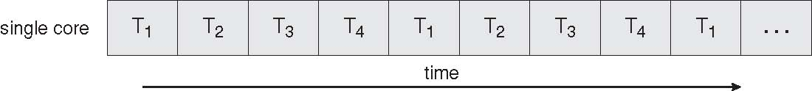
Concurrent Execution on a Single-core System

Slide 9
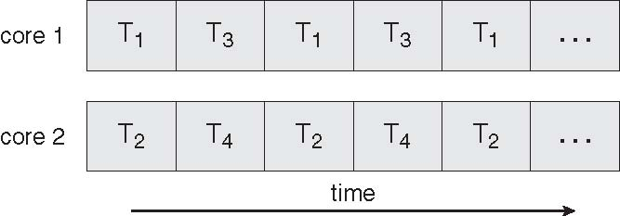
Parallel Execution on a Multicore System

Slide 10
Multicore Programming
Multicore systems putting pressure on programmers, challenges include
  Dividing activities – separate concurrent tasks
  Balance – task perform equal work
  Data splitting – Data accessed/manipulated must be divided
  Data dependency – Reducing too much data dependencies
  Testing and debugging – many execution paths are possible in code, testing/debugging such concurrent programs is inherently difficult than single-threaded applications

Slide 11
User Threads
Thread management done by user-level threads library
Three primary thread libraries:
  POSIX Pthreads
  Win32 threads
  Java threads

Slide 12
Kernel Threads
Supported by the Kernel
Examples
  Windows XP/2000
  Solaris
  Linux
  Tru64 UNIX
  Mac OS X

Slide 13
Multithreading Models
Many-to-One
One-to-One
Many-to-Many

Slide 14
Many-to-One
Many user-level threads mapped to single kernel thread
Entire process will block if thread makes a blocking system call.
Also, as only one thread can access the kernel at a time, multiple threads are unable to run in parallel on Multiprocessors.
Examples:
  Solaris Green Threads
  GNU Portable Threads

Slide 15
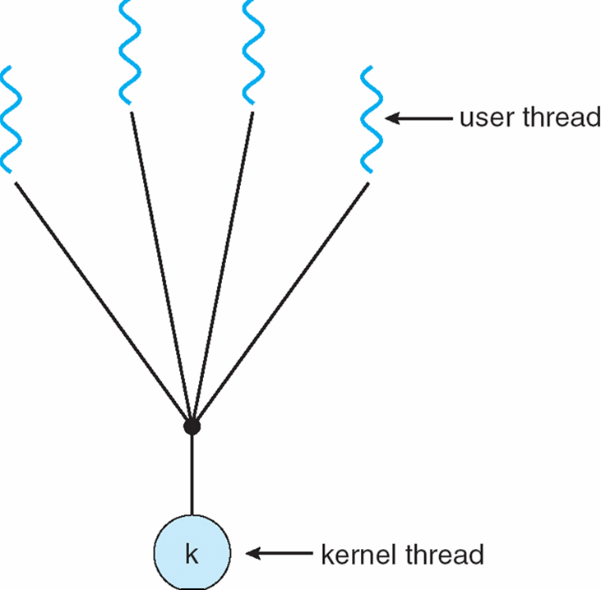
Many-to-One Model

Slide 16
One-to-One
Each user-level thread maps to kernel thread
Both the problems found in Many-to-One are resolved here.
Examples
  Windows NT/XP/2000
  Linux
  Solaris 9 and later

Slide 17
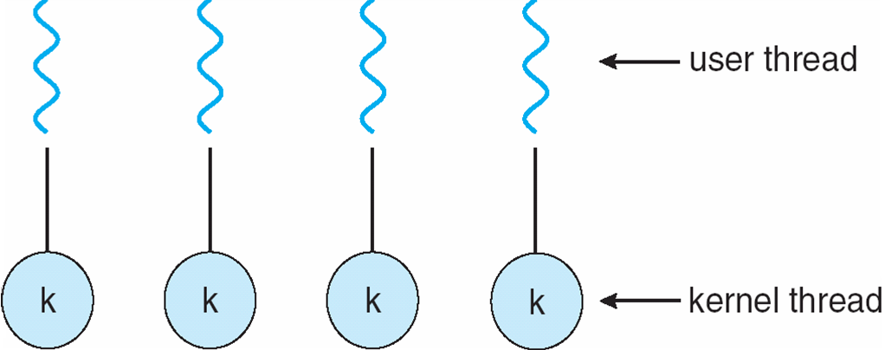
One-to-one Model

Slide 18
Many-to-Many Model
Allows many user level threads to be mapped to many kernel threads
Allows the operating system to create a sufficient number of kernel threads
Solaris prior to version 9
Windows NT/2000 with the ThreadFiber package

Slide 19

Many-to-Many Model

Slide 20
Two-level Model
Similar to M:M, except that it allows a user thread to be bound to kernel thread
Examples
  IRIX
  HP-UX
  Tru64 UNIX
  Solaris 8 and earlier

Slide 21
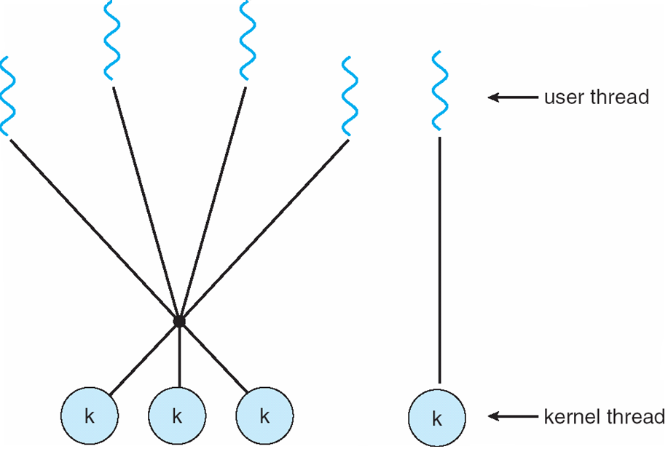
Two-level Model

Slide 22
Thread Libraries
Thread library provides programmer with API for creating and managing threads
Two primary ways of implementing
  Library entirely in user space with no kernel support. All Code and Data Structures for library exist in User Space.
    Means invoking function of library results in local function call in user space not a System call.
  Kernel-level library supported by the OS. All Code and Data Structures for library exist in Kernel Space.
    Means invoking function in API for the library results in System call to the kernel.

Slide 23
Pthreads
May be provided either as user-level or kernel-level
Pthreads refers to the POSIX standard (IEEE 1003.1c) defining an API for thread creation and synchronization
API specifies behavior of the thread library, implementation is up to development of the library
Common in UNIX operating systems (Solaris, Linux, Mac OS X)

Slide 24
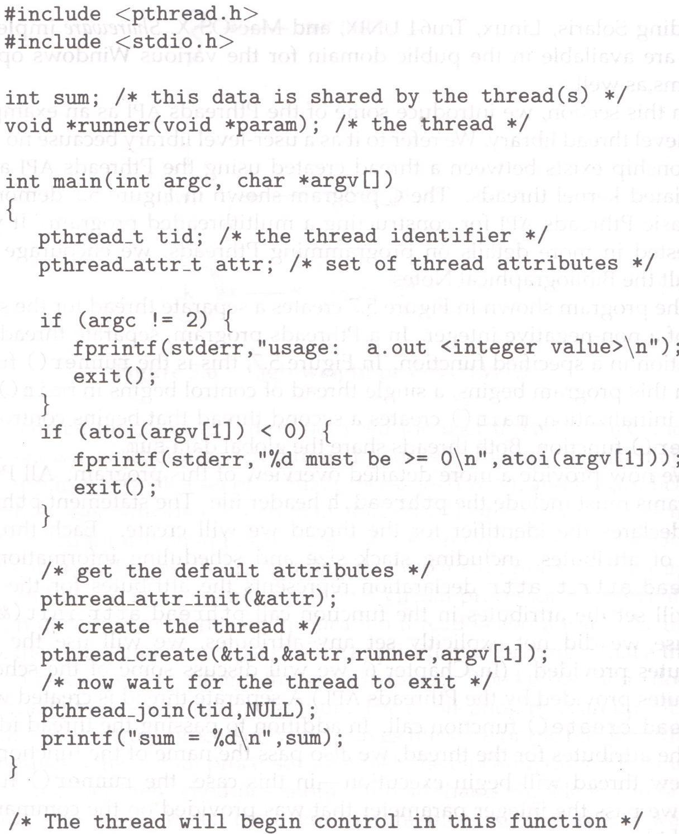
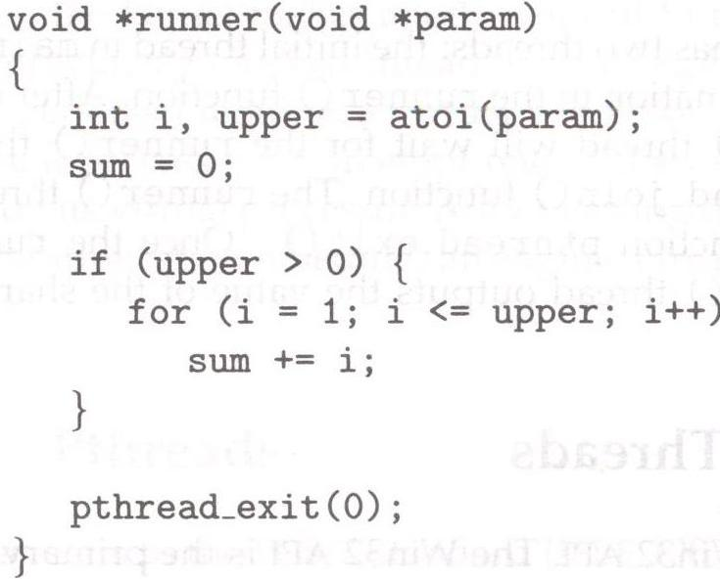

Slide 25

Java Threads
Java threads are managed by the JVM
Typically implemented using the threads model provided by underlying OS
Java threads may be created by:
  Extending Thread class
  OR
  Implementing the Runnable interface

Slide 26
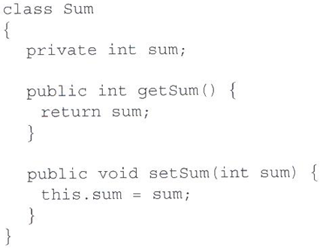
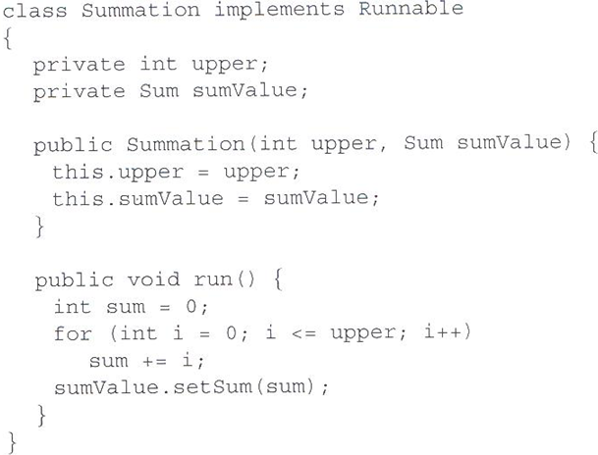
Java Threads - Example Program

Slide 27
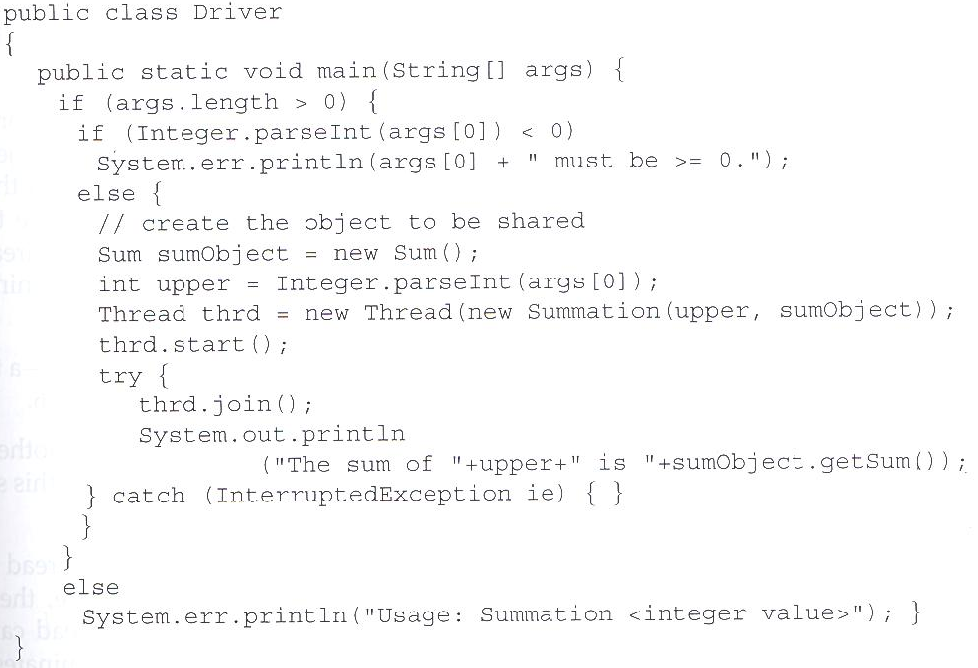
Java Threads - Example Program

Slide 28
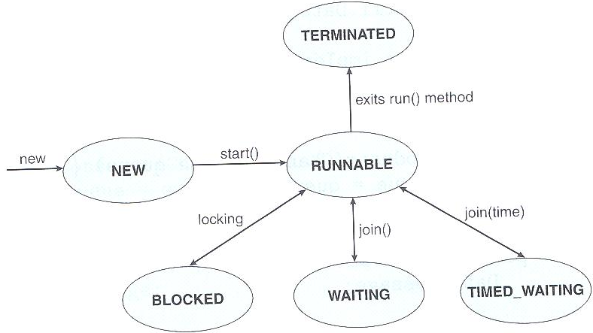
Java Thread States

Slide 29
Threading Issues
Semantics of fork() and exec() system calls
Thread cancellation of target thread
  Asynchronous or deferred
Signal handling
Thread pools
Thread-specific data
Scheduler activations

Slide 30
Semantics of fork() and exec()
Does fork() duplicate only the calling thread or all threads of process?

Slide 31
Thread Cancellation
Terminating a thread before it has finished
Two general approaches:
  Asynchronous cancellation terminates the target thread immediately
  Deferred cancellation allows the target thread to periodically check if it should be cancelled

Slide 32

Thread Cancellation
Deferred cancellation in Java
Interrupting a thread

Slide 33
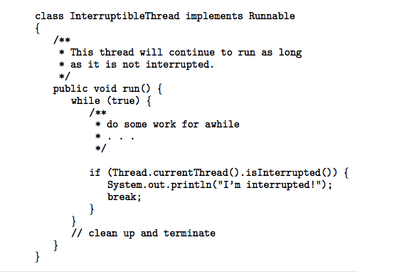
Thread Cancellation
Deferred cancellation in Java - Checking interruption status

Slide 34
Signal Handling
Signals are used in UNIX systems to notify a process that a particular event has occurred
A signal handler is used to process signals
  Signal is generated by particular event
  Signal is delivered to a process
  Signal is handled
Options:
  Deliver the signal to the thread to which the signal applies
  Deliver the signal to every thread in the process
  Deliver the signal to certain threads in the process
  Assign a specific thread to receive all signals for the process

Slide 35
Thread Pools
Create a number of threads in a pool where they await work
Advantages:
  Usually slightly faster to service a request with an existing thread than create a new thread
  Allows the number of threads in the application(s) to be bound to the size of the pool

Slide 36
Thread Pools
Java provides 3 thread pool architectures:
1. Single thread executor - pool of size 1.
2. Fixed thread executor - pool of fixed size.
3. Cached thread pool - pool of unbounded size

Slide 37
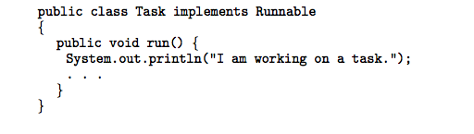
Thread Pools
A task to be serviced in a thread pool

Slide 38
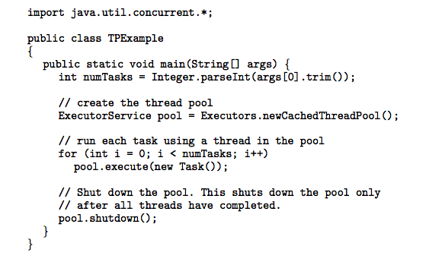
Thread Pools
Creating a thread pool in Java

Slide 39
Thread Specific Data
Allows each thread to have its own copy of data
Useful when you do not have control over the thread creation process (i.e., when using a thread pool)

Slide 40
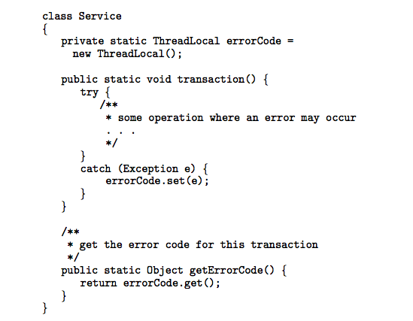
Thread Specific Data
Thread-specific data in Java.
Class Worker implements Runnable
{
private static Service provider;
public void run()
{
provider.transaction();
System.out.println(provider.getErrorCode() ):
}
}
___________________________________________
ThreadLocal class is used for declaring thread specific data (errorCode).
ThreadLocal data can be initialized with either by its set() or its initialValue( ) method.
transaction(); can be invoked by any no of threads.

Slide 41
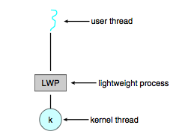
Scheduler Activations
Both M:M and Two-level models require communication to maintain the appropriate number of kernel threads allocated to the application
Scheduler activations provide upcalls - a communication mechanism from the kernel to the thread library
This communication allows an application to maintain the correct number kernel threads

Slide 42
Operating System Examples
Windows XP Threads
Linux Thread

Slide 43
Windows XP Threads
Implements the one-to-one mapping, kernel-level
Each thread contains
  A thread id
  Register set
  Separate user and kernel stacks
  Private data storage area
The register set, stacks, and private storage area are known as the context of the threads
The primary data structures of a thread include:
  ETHREAD (executive thread block)
  KTHREAD (kernel thread block)
  TEB (thread environment block)

Slide 44
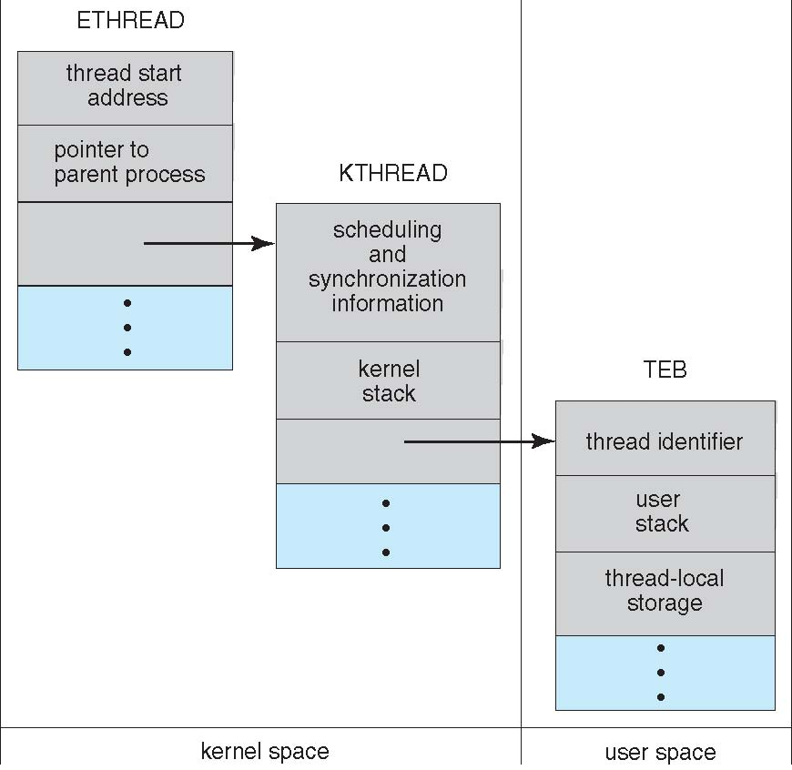
Windows XP Threads

Slide 45
Linux Threads
Linux refers to them as tasks rather than threads
Thread creation is done through clone() system call
clone() allows a child task to share the address space of the parent task (process)

Slide 46
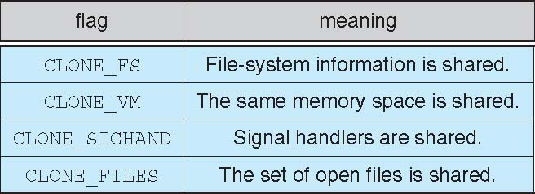
Linux Threads

Slide 47
End of Chapter 14

